Slide 1

Machine Learning for Fraud Detection
Using Random Forests to Identify Fraudulent Transactions
Presented by Terry Brown, Elijah Mercier and Ivanna Price

Slide 2


About Our Project
Our project focused on using machine learning to detect fraudulent transactions in financal datasets.
Industry: Finance
Model Used: Random Forest Classifier
In this presentation, we will demonstrate how we successfully built a model that achieved over
95% accuracy in identifying fraudulent transactions.

Slide 3


WHY FRAUD DETECTION MATTERS:
Billions of dollars are lost to fraud annually.
Detecting fraudulent transactions in real-time can save money and improve consumer trust.
Our Goal: Develop a predictive model to identify fraudulent transactions using machine learning.

Slide 4
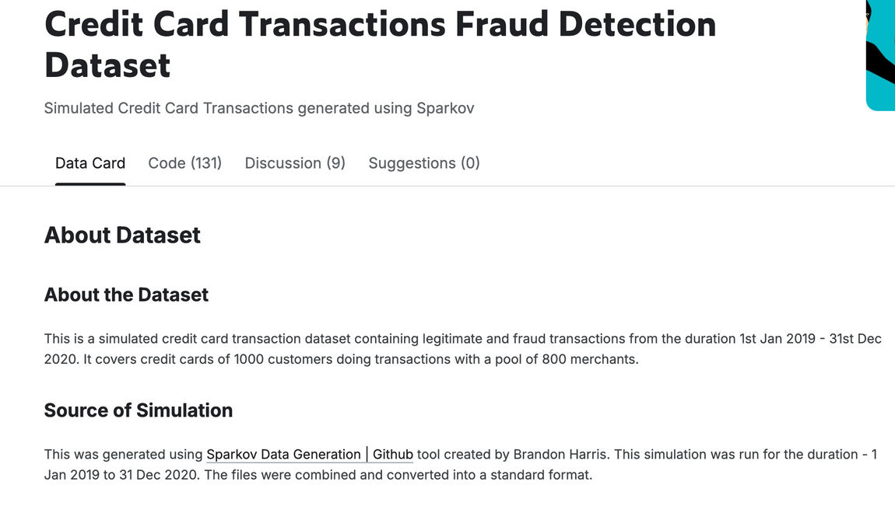
Data Collection
The data was sourced from Kaggle’s "Fraud Detection" dataset.
Our dataset included over 1 million records with 23 features.
Highlight important features like amt, lat, long, transaction_year, transaction_month, etc.
Target Variable: is_fraud (1 indicates fraud, 0 indicates non-fraud)

Slide 5
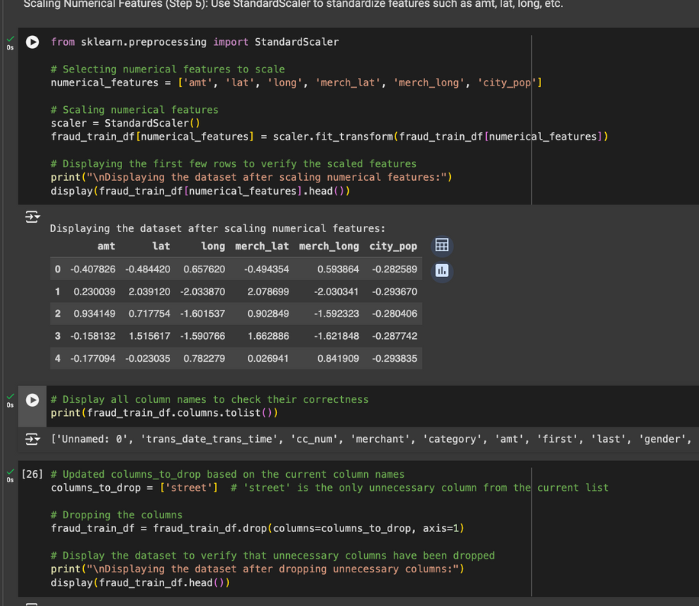

Data Preparation
Effectively cleaned data in cases such as:
Removing unnecessary columns like street, cc_num, dob.
Converting trans_date_trans_time to separate year, month, day, hour features.
Encoding Categorical Variables: label encoding for gender, job, category.

Slide 6
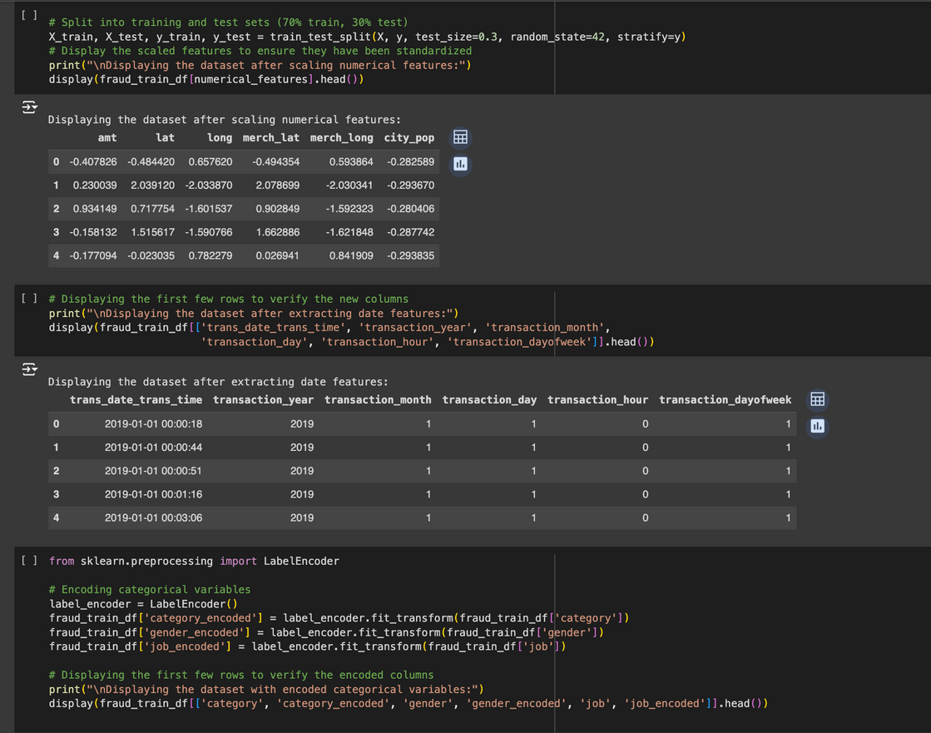
Model Selection and Training
Chosen Model: Random Forest Classifier
Justification: The Random Forest model is robust, handles large datasets, and deals with feature importance well.
Training Process:
Split data into training (70%) and testing (30%) sets.
Used scikit-learn to train the model with 50 estimators.
train_test_split() splits the data into 70% training and 30% testing, using stratify=y to ensure the is_fraud ratio is maintained in both sets.

Slide 7
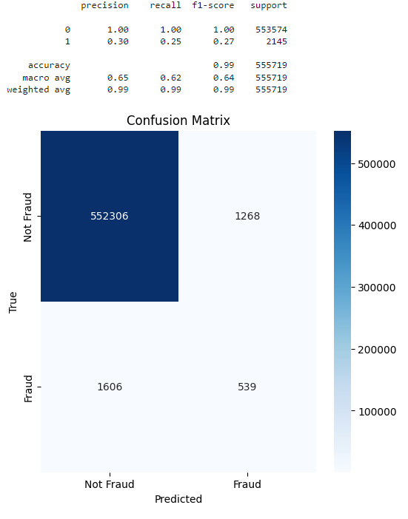
Model Evaluation
Metrics Used:
Accuracy: 99%
Precision, Recall, F1-Score
Confusion Matrix: Expresses accuracy of model by comparing predicted values with actual values
Model correctly identified 552,306 non-fraudulent transactions with very few false positives. The model correctly detected 539 fraud cases, but missed 1,606, indicating room for improvement
Precision, Recall, Accuracy, Weighted Average Score:
The accuracy score of 0.99 indicates excellent model performance.

Slide 8
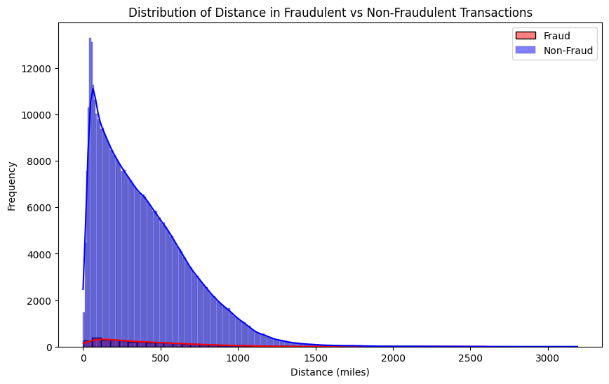
Distance Distribution
Overview: Represents the distribution of distances between the cardholder’s address and the retailer’s location for fraudulent and non-fraudulent transactions.
Non-fraudulent transactions
Most occur over short distances, peaking around 0 - 100 miles
Fraudulent transactions
More spread out across a wider range of distances compared to non-fraudulent transactions
Noticeable “tail” of fraudulent transactions at larger distances (500+) miles

Slide 9
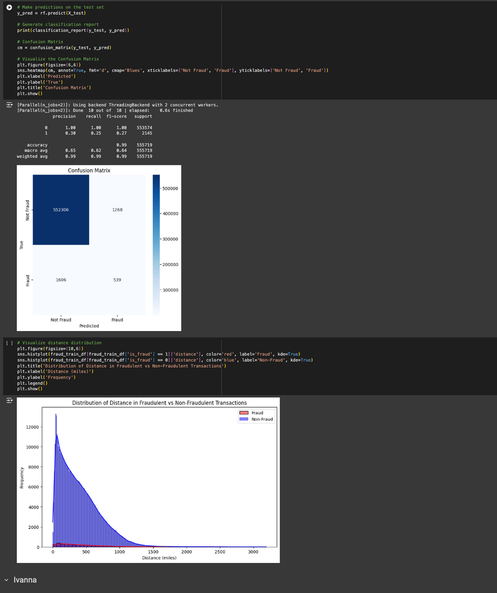
Data Exploration and Analysis
Exploratory Data Analysis (EDA):
Visualized distributions of transaction amounts (amt) and distances to locations (miles).
Analyzed correlations between features and the target variable.
Key Insights:
Most fraudulent transactions occurred less than 500 miles away.
Certain categories (e.g., amount) had higher impact on probability of fraud rate.

Slide 10
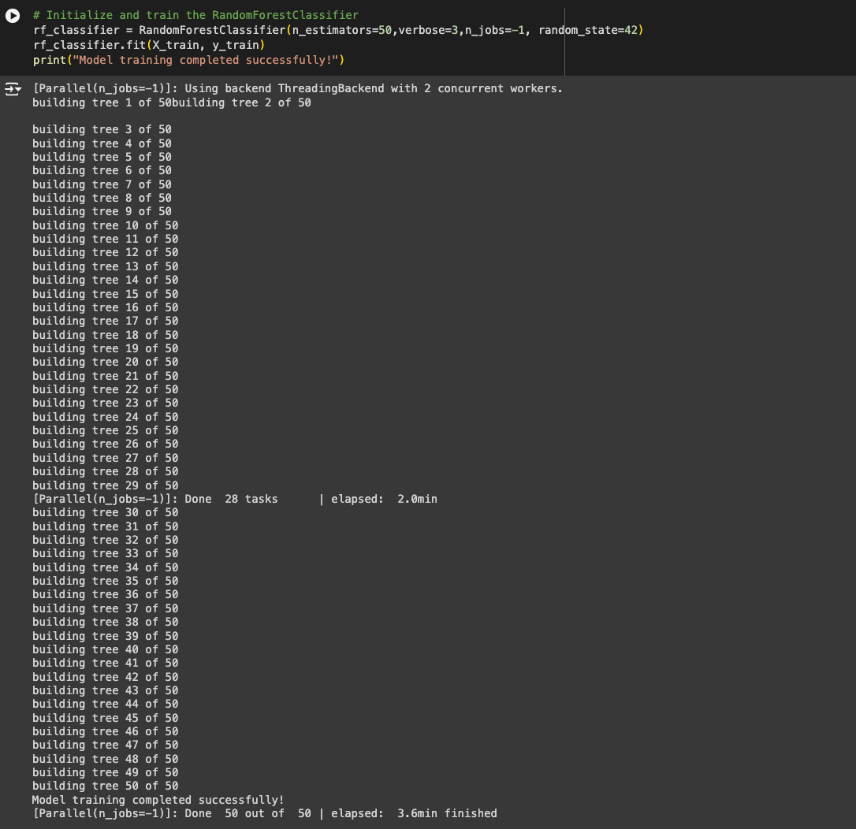
Model Selection and Training 2
n_estimators=50: Specifies that the model will create 50 decision trees.
random_state=42: Ensures reproducibility.
rf_classifier.fit(X_train, y_train): Trains the model using the training dataset.

Slide 11
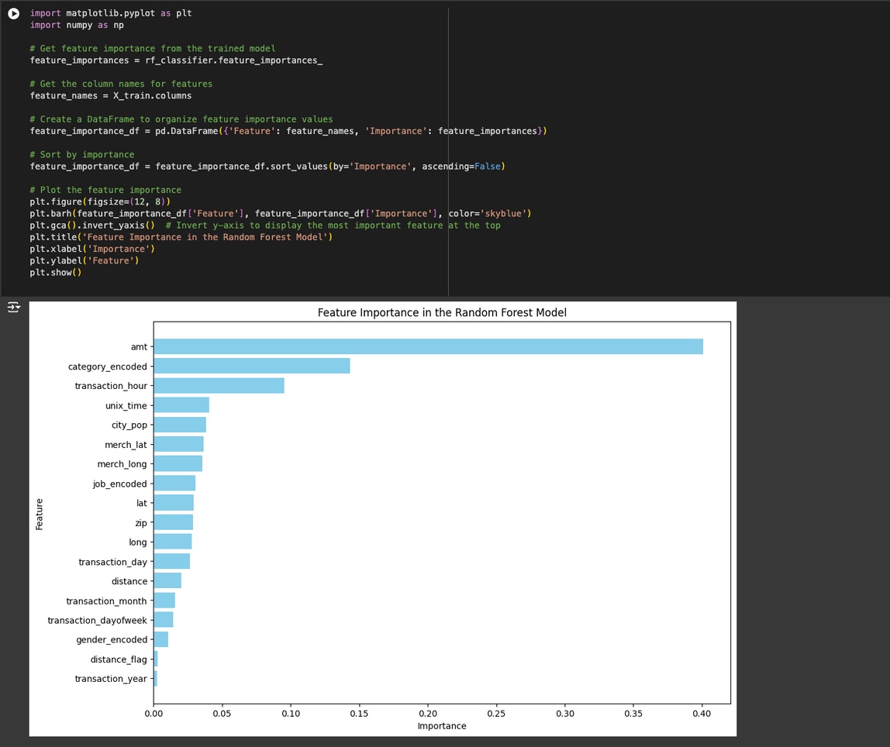
Feature Importance
Transaction amount (amt): Most important feature in detecting fraud. Higher transaction amounts could be indicative of fraud
Category (category_encoded): Second most important feature. The type of merchant or transaction category (e.g., travel, entertainment, or personal care) can be significant in identifying fraudulent behavior
Distance is relevant, but is not a strong predictor when compared to the features noted above

Slide 12



Challenges and Solutions
Challenges Faced:
Handling imbalanced data: Fraud cases were much fewer than non-fraud cases.
Dealing with categorical data and timestamps.
Solutions Implemented:
Used stratified sampling and handled imbalanced data with appropriate evaluation metrics.

Slide 13
Conclusion
Key Takeaways:
The Random Forest model effectively identified fraudulent transactions with high accuracy.
Feature importance analysis revealed that transaction amount (amt) and distance from location (miles) were critical indicators.
Business Impact: Our model can be deployed to detect fraudulent transactions in real-time, potentially saving financial institutions millions of dollars.

Slide 14

Thank You

